Slide 1
Cisco 7841 End User Training

Slide 2
Welcome
Instructor: Name
Schedule: One hour and fifteen minutes
Phone Orientation
Call Handling Features
Voice Mail
Reference Cards
Conversion: Date and Details
Cell Phone Consideration

Slide 3
Cisco 7841 IP Phone

Slide 4
Phone Orientation

Slide 5
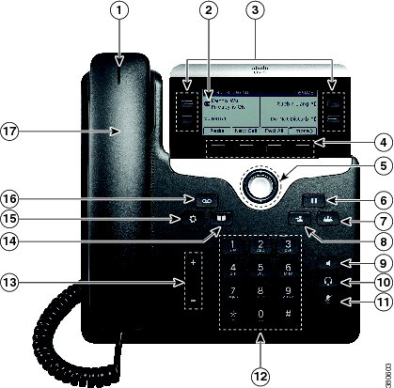
Phone Orientation

Slide 6
Call Handling Features

Slide 7
Placing Calls
To place a call:
Lift the handset or Press the Speaker button or Press the Headset button or Press the New Call softkey or Press a line button
Dial the number

Slide 8
Dialing
To call an extension number:
Dial the 5-digit extension number
To call an external telephone number:
Dial 9 + 1 + telephone number
To call Emergency Services:
Dial 911 or 9 + 911

Slide 9
Answering Calls
To answer an incoming call:
Lift the handset or Press the Speaker button or Press the Headset button or Press the Answer softkey or Press the flashing amber line button

Slide 10
Phone Screen and Call Icons
Icon | Status
 | Line in Use
 | Line on Hold

Slide 11
Call States
Solid green: Active call.
Flashing green: Held call.
Flashing amber: Incoming call.
Solid red: Shared line in use.

Slide 12
Call Hold
To place a call on hold:
Press the Hold button
To retrieve a held call:
Press the Hold button Press the Resume softkey or Press the flashing green line button

Slide 13
Placing a Second Call
To place a second call on the same line:
Press the Hold button
Press the New Call softkey
Dial the number
To disconnect from second call and return to first:
Press the End Call softkey
Press the Resume softkey or Press the flashing green line button

Slide 14
Answering a Second Call
To answer a second incoming call:
Press the flashing amber line button

Slide 15
Managing Multiple Calls
To toggle between two held calls on the same line:
Press the flashing line button
To toggle between three or more held calls on the same line:
Press the flashing line button
Navigate to the held call
Press the Resume softkey

Slide 16
Ending Calls
To end a call:
Replace the handset or Press the Speaker button or Press the Headset button or Press the End Call softkey

Slide 17
Shared Line Appearances
To answer a call on a shared line:
Press the flashing amber line button
To toggle between held calls on shared lines:
Press the flashing green/red line button

Slide 18
Redial
To redial the last number called:
Press the Redial softkey
To view a list of recently called numbers:
Press up on the navigation pad

Slide 19
Speed Dial
To place a speed dial call:
While on-hook, enter the speed dial code
Press the SpeedDial softkey

Slide 20
Call Transfer
To transfer a call:
Press the Transfer button
Dial the 4-digit extension number or 9 + 1 + the telephone number*
Option: Announce the caller
Press the Transfer button or Transfer softkey

Slide 21
Call Transfer
If no answer or line is busy:
Press the Cancel softkey
Press the Resume softkey or Press the flashing green line button
To toggle between calls:
Press the Swap softkey

Slide 22
Direct Call Transfer
To transfer two callers on the same line to one another:
While connected to an active call, press the Transfer button
Press the flashing line button
Press the Yes softkey to confirm and complete the transfer

Slide 23
Call Transfer to Voice Mail
To transfer a call to a subscriber’s voice mail box:
Press the Transfer button
Dial * + the voice mailbox number
Press the Transfer button or Transfer softkey

Slide 24
Conference Calling – Ad Hoc
To place up to a 6-way conference call:
While connected to an active call, press the Conference button
Dial the next participant
Option: Announce the conference
Press the Conference button or Conference softkey
To add additional participants:
Repeat the above steps

Slide 25
Conference Calling – Ad Hoc
To add an incoming caller to an existing call or conference:
While connected to the incoming call, press the Conference button
Press the flashing line button
Press the Yes softkey to confirm and complete the conference

Slide 26
Conference Calling – List
To view conference participants:
Press the Details softkey
To remove a conference participant:
Navigate to the participant to remove
Press the Remove softkey

Slide 27
Call Forwarding
Call Forward Busy – forwards a call on a busy condition to the line’s call coverage destination.
Call Forward No Answer – forwards a call on a ring no answer condition to the line’s call coverage destination.

Slide 28
Call Forwarding
To immediately forward all your incoming calls to another number:
While on-hook, press the Fwd All softkey
Dial the 5-digit extension number or 9 + 1 + telephone number* or Press the Messages button
To deactivate call forwarding:
Press the Fwd Off softkey

Slide 29
Call Divert
To immediately forward a ringing, live, or held call to voice mail:
Press the Divert softkey

Slide 30
Do Not Disturb
To disable/re-enable the ringer for all incoming calls:
While on-hook, press the DND softkey

Slide 31
Call PickUp*
To answer a ringing call on a call pickup group members phone:
Go off-hook
Press the PickUp softkey
Press the Answer softkey
* Assigned to lines requiring this functionality.

Slide 32
Call Park
To put a call on hold at one phone and retrieve it at another:
Press the Park softkey
Note: Displayed Park number: 711XX
Hang up
To retrieve a parked call:
Dial the park number: 711XX

Slide 33
Extension Mobility
To temporarily configure another Cisco 7800 phone as your own:
Press the Applications button
Select Extension Mobility
Enter your UserID: Employee ID
Enter your PIN: Network Password
Press the Submit softkey
Press the Exit softkey

Slide 34
Self Care Portal
To customize your phone with speed dials and other options:
Enter into a web browser: https://10.252.220.5/ucmuser
Enter your Username: Employee ID Enter your Password: 1 2 3 4 5
Select Sign In

Slide 35
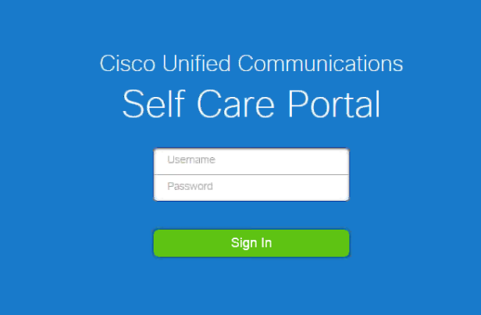

Slide 36
Voice Mail

Slide 37
Calling Voice Mail
To call Voice Mail for the first time:
Press the Messages button
Enter your starter PIN followed by #
Starter PIN: 1 2 3 4

Slide 38
Voice Mail Enrollment
To initialize your voice mailbox:
Press the Messages button
Enter the Starter PIN followed by #
Record your First and Last Name
Record a Personal Greeting
Enter a PIN
Select to keep your directory status

Slide 39
Calling Voice Mail
To call Voicemail from your desk:
Press the Messages button
Enter your PIN followed by #
To call Voicemail from an outside line:
Dial __________________
Press *
Enter your Mailbox ID Number followed by #
Enter your PIN followed by #
Mailbox ID Numbers: 5-digit extension number

Slide 40
Voice Mail Main Menu
1 Play New Messages
2 To Send a Message
3 Review Old Messages
4 Setup Options
Tips:
* Exit or back-up
0 for Help
## number and spelling entry toggle

Slide 41
1 or 3 During Message Review
Repeat | Save | Delete
1 | 2 | 3
Slow | Volume | Fast
4 | 5 | 6
Back | Pause | Forward
7 | 8 | 9
Cancel | Help | End
* | 0 | #

Slide 42
1 or 3 After Message Review
Repeat | Save | Delete
1 | 2 | 3
Reply | Forward | New
4 | 5 | 6
Back |  | Properties
7 | 8 | 9
Cancel | Help | New
* | 0 | #

Slide 43
2 – Send a Message
Record your Message
Enter the extension or spell the name of the person or distribution list followed by #
Press 9 1 to add a name
Press # to send or choose from a delivery option
Delivery Options:
Mark urgent | Request return receipt | Mark private
1 | 2 | 3
Set future delivery | Review recording | Re-record message
4 | 5 | 6
Add to the message
7 | 8 | 9
Cancel | Help | Send
* | 0 | #

Slide 44
4 – Setup Options
1 - Greetings:
1 – Edit the standard greeting
2 – Turn on/off alternate greeting
3 – Edit other greetings
4 – Play all greetings
2 – Message Settings: 1 – Message notification
3 – Menu style
4 – Private lists
3 – Personal Settings:
1 – PIN
2 – Recorded name
3 – Directory listing

